Slide 1

5 cool scientific inventions
By Anirudh Vempati

Slide 2

Hello

Slide 3

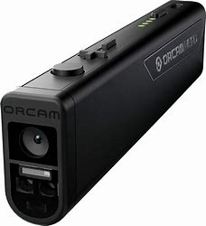
OrCam Read Release date: July 2023

Slide 4

Dall-e Release date: January 5, 2021

Slide 5


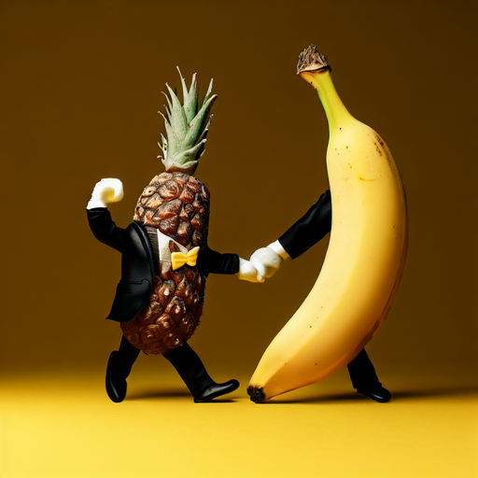
Monkey talking in banana phone retro
A blue dragon breathing fire in a dark forest
A pineapple wearing a tuxedo and dancing with a banana

Slide 6

Luci Release date: 2020

Slide 7

LLaMA Release date: February 2023

Slide 8
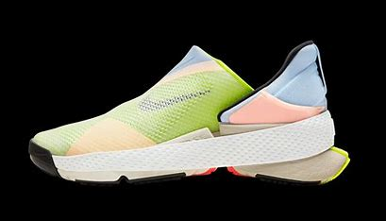
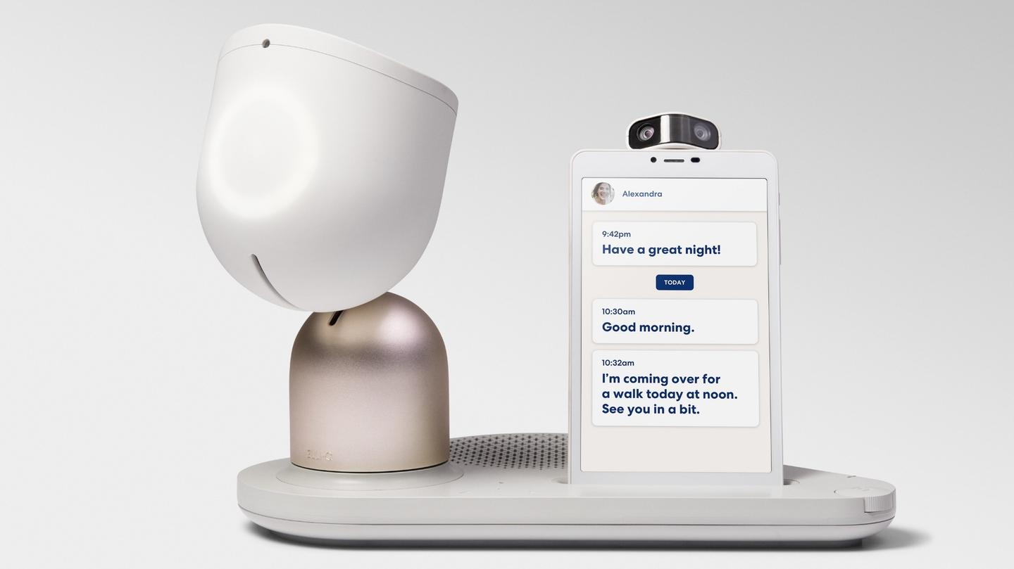
Elliq Release date: Mar 15, 2022

Slide 9
Thank You

